Slide 1



Searching and Hashing
Swati Mali
swatimali@somaiya.edu

Slide 2
Outline
Search concept
Searching applications
Linear Search
Binary Search
Hashed List Search
Comparison of searching Techniques

Slide 3
Searching
Search is a process to retrieve information stored within some data structure, or calculated in the search space of a problem domain, either with discrete or continuous values.

Slide 4
Problem: Search
We are given a list of records.
Each record has an associated key.
Give efficient algorithm for searching for a record containing a particular key.
Efficiency is quantified in terms of average time analysis (number of comparisons) to retrieve an item.

Slide 5
Search
[ 0 ]
[ 1 ]
[ 2 ]
[ 3 ]
[ 4 ]
[ 700 ]
…
Number 701466868
Number 281942902
Number 233667136
Number 580625685
Number 506643548
Number 155778322
Each record in list has an associated key.
In this example, the keys are ID numbers.
Given a particular key, how can we efficiently retrieve the record from the list?
Number 580625685

Slide 6
Searching applications
Problems in combinatorial optimization, such as:
The vehicle routing problem, a form of shortest path problem
The knapsack problem: Given a set of items, each with a weight and a value, determine the number of each item to include in a collection so that the total weight is less than or equal to a given limit and the total value is as large as possible.
The nurse scheduling problem
Problems in constraint satisfaction, such as:
The map coloring problem
Filling in a sudoku or crossword puzzle
In game playing and especially multiplayer game playing, choosing the best move to make next (such as with the minmax algorithm)
Ref: https://en.wikipedia.org/wiki/Search_algorithm#Applications_of_Search_Algorithms

Slide 7
Searching applications
Finding a combination or password from the whole set of possibilities
Factoring an integer (an important problem in cryptography)
Optimizing an industrial process, such as a chemical reaction, by changing the parameters of the process (like temperature, pressure, and pH)
Retrieving a record from a database
Finding the maximum or minimum value in a list or array
Checking to see if a given value is present in a set of values

Slide 8
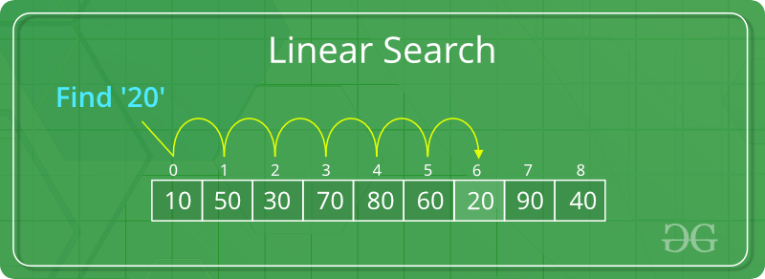
Linear Search
The list or data structure is traversed sequentially and every element is checked for presence of some information
Image courtesy: https://www.geeksforgeeks.org/searching-algorithms/

Slide 9
Linear search Search
Step through array of records, one at a time.
Look for record with matching key.
Search stops when
record with matching key is found
or when search has examined all records without success.

Slide 10
Pseudocode for Linear Search
// Search for a desired item in the n array elements
// starting at a[first].
// Returns pointer to desired record if found.
// Otherwise, return NULL
…
for(i = first; i < n; ++i )
if(a[first+i] is desired item)
return &a[first+i];
// if we drop through loop, then desired item was not found
return NULL;

Slide 11
Linear Search
Advantages
Fast searches of small to medium lists.
The list does not need to sorted.
Not affected by insertions and deletions
Disadvantages
Slow searching of large lists
time taken to search the elements is proportional to the number of elements.

Slide 12
Binary Search
Divide and conquer
Needs the input to be sorted
One of the fastest searching algorithms.

Slide 13
Binary Search algorithm
Algorithm integer binarySearch(int arr[], int low, int high, int SearchKey)
// Arr[0:n-1] array of N elements, SearchKey is key to be searched. Low and High are lowest and highest indices in array arr[0:n-1]
{
if (low <= high)
{
mid = (low+ high)/2;
if (arr[mid] == SearchKey) return mid;
if (arr[mid] > SearchKey)
return binarySearch(arr, low, mid-1, SearchKey);
else
return binarySearch(arr, mid+1, high, SearchKey);
}
// if the element is not present in array
return -1;
}

Slide 14
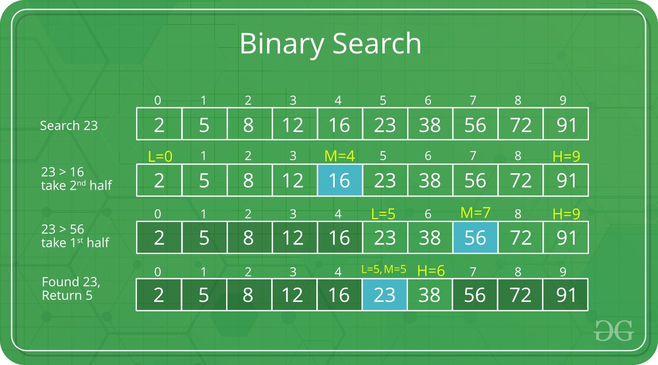
Binary search example

Slide 15
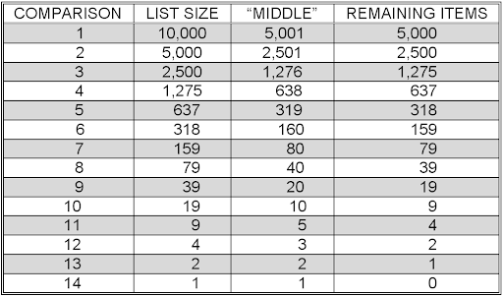
Binary search and number of comparisons
Image courtesy: http://watson.latech.edu/book/algorithms/algorithmsSearching2.html

Slide 16
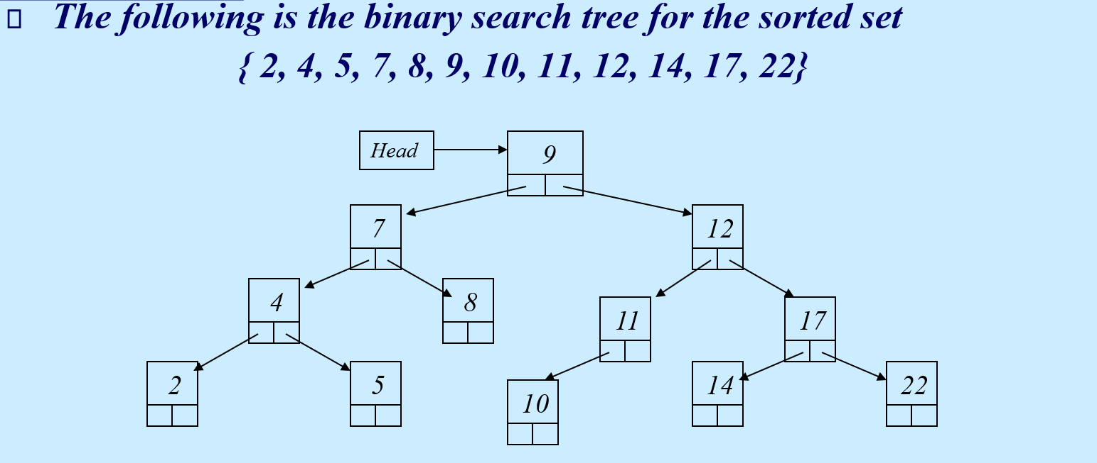
Binary Search

Slide 17
Binary search
Advantages
Efficient search
It indicates whether the element being searched is present before or after the current position in the list.
This information is used to narrow the search.
Works best for larger datasets
Disadvantages
Recursion takes more space
Input needs to be sorted
Gets affected by insertions and deletions in the input list

Slide 18
Hashing and hash tables

Slide 19
Concept of Hashing
In CS, a hash table, or a hash map, is a data structure that associates keys (names) with values (attributes).
Look-Up Table
Dictionary
Cache
Extended Array

Slide 20
Just An Idea
Hash table :
Collection of pairs,
Lookup function (Hash function)
Hash tables are often used to implement associative arrays,
Worst-case time for Get, Insert, and Delete is O(size).
Expected time is O(1).

Slide 21
Hash Tables
Constant time accesses!
A hash table is an array of some fixed size, usually a prime number.
General idea:
hash table
0
 | …
hash function:
h(K)
key space (e.g., integers, strings)
TableSize –1

Slide 22
Example
0
1
2
3
4
5
6
7
8
9
key space = integers
TableSize = 10
h(K) = K mod 10
Insert: 7, 18, 41, 94

Slide 23
Hash Functions
simple/fast to compute,
Avoid collisions
have keys distributed evenly among cells.
Perfect Hash function:

Slide 24
Search vs. Hashing
Search tree methods: key comparisons
Time complexity: O(size) or O(log n)
Hashing methods: hash functions
Expected time: O(1)
Is hashing better than searching?

Slide 25
Sample Hash Functions:
26 letters, 10 digits, 1 _ = 37 possible characters
key space = strings
s = s₀ s₁ s₂ … s _{k-1}
h(s) = s₀ mod TableSize
h(s) = mod TableSize
h(s) = mod TableSize
Spread: 37
K*37
SPOT, POST,STOP
[s0 + s1*37 + s2*37^2+s3*37^3…] = O(37^k+1)
Notes:
3) Takes the position of each character into account, like with a positional number system.
[s0 + s1*37 + s2*37^2+s3*37^3]

Slide 26
Some hash functions
Middle of square
H(x):= return middle digits of x^2
Division
H(x):= return x % k
Multiplicative:
H(x):= return the first few digits of the fractional part of x*k, where k is a fraction.
advocated by D. Knuth in TAOCP vol. III.

Slide 27
Some hash functions II
Folding:
Partition the identifier x into several parts, and add the parts together to obtain the hash address
e.g. x=12320324111220; partition x into 123,203,241,112,20; then return the address 123+203+241+112+20=699
Shift folding vs. folding at the boundaries
Digit analysis:
If all the keys have been known in advance, then we could delete the digits of keys having the most skewed distributions, and use the rest digits as hash address.

Slide 28
Properties of a good hash function
Randomization
Less collisions

Slide 29
Choice of Hash Function
Requirements
easy to compute
minimal number of collisions
If a hashing function groups key values together, this is called clustering of the keys.
A good hashing function distributes the key values uniformly throughout the range.

Slide 30
Collision Resolution
Collision: when two keys map to the same location in the hash table.
Two ways to resolve collisions:
Separate Chaining
Open Addressing (linear probing, quadratic probing, double hashing)

Slide 31
Open Addressing
Insert:
38
19
8
109
10
0
1
2
3
4
5
6
7
8
9
Linear Probing: after checking spot h(k), try spot h(k)+1, if that is full, try h(k)+2, then h(k)+3, etc.

Slide 32
Linear Probing
f(i) = i
Probe sequence:
0th probe = h(k) mod TableSize
1th probe = (h(k) + 1) mod TableSize
2th probe = (h(k) + 2) mod TableSize
. . .
i^{th} probe = (h(k) + i) mod TableSize
Notes:
Add a function of I to the original hash value to resolve the collision.
Primary clustering – we notice this effect in the previous slide.
Any key that hashes into the cluster 1) will require several attempts to resolve collision and 2) will then add to the cluster. (Both 1 and 2 are bad)

Slide 33
Quadratic Probing
Less likely to encounter Primary Clustering
f(i) = i²
Probe sequence:
0th probe = h(k) mod TableSize
1th probe = (h(k) + 1) mod TableSize
2th probe = (h(k) + 4) mod TableSize
3th probe = (h(k) + 9) mod TableSize
. . .
i^{th} probe = (h(k) + i²) mod TableSize
f(i+1) = f(i) + 2i + 1
Notes:
Add a function of I to the original hash value to resolve the collision.
Less likely to encounter primary clustering, but could run into secondary clustering.
Although keys that hash to the same initial location will still use the same sequence of probes (and conflict with each other).
How big to make hash table? Lambda = ½, (hash table is twice as big as the number of elements expected.)
Note: (i +1)² – i² = 2i + 1 Thus, to get to the NEXT step, you can add 2* current value of i plus one.

Slide 34
Quadratic Probing
0
1
2
3
4
5
6
7
8
9
Insert:
89
18
49
58
79

Slide 35
Double Hashing
f(i) = i * g(k) where g is a second hash function
Probe sequence:
0th probe = h(k) mod TableSize
1th probe = (h(k) + g(k)) mod TableSize
2th probe = (h(k) + 2*g(k)) mod TableSize
3th probe = (h(k) + 3*g(k)) mod TableSize
. . .
i^{th} probe = (h(k) + i*g(k)) mod TableSize
Notes:
So the probe sequence is a function of the key in two different ways – for the original starting location (h(k) AND for the amount of offset you move out each time you have a collision (g(k)). (as opposed to both linear probing and quadratic probing where the offset is independent of the key)
** In choosing g care must be taken so that it never evaluates to 0.
A good choice for g is to choose a prime R < TableSIze and let g(k) = R – (k mod R).
Double Hashing is Safe for λ < 1

Slide 36
Double Hashing Example
h(k) = k mod 7 and g(k) = 5 – (k mod 5)
76
93
40
47
10
55
0
0
0
0
0
0
1
1
1
1
47
1
47
1
47
2
2
93
2
93
2
93
2
93
2
93
3
3
3
3
3
10
3
10
4
4
4
4
4
4
55
5
5
5
40
5
40
5
40
5
40
6
76
6
76
6
76
6
76
6
76
6
76
Probes 1 1 1 2 1 2

Slide 37
Linear Probing – example
Divisor = b (number of buckets) = 17.
Home bucket = key % 17.
Collision resolution: [h(k)+1] mod bucketsize
0
4
8
12
16
34
0
45
6
23
7
28
12
29
11
30
33
Insert pairs whose keys are 6, 12, 34, 29, 28, 11, 23, 7, 0, 33, 30, 45
#collisions?

Slide 38
Quadratic Probing – example
Divisor = b (number of buckets) = 17.
Home bucket = key % 17.
Collision resolution= [h(k)+i²) mod bucketsize
0 | 1 | 2 | 3 | 4 | 5 | 6 | 7 | 8 | 9 | 10 | 11 | 12 | 13 | 14 | 15 | 16
Insert pairs whose keys are 6, 12, 34, 29, 28, 11, 23, 7, 0, 33, 30, 45
#collisions?

Slide 39
Separate chaining– example
Divisor = b (number of buckets) = 17.
Home bucket = key % 17.
Collision resolution= separate chaining
0 | 1 | 2 | 3 | 4 | 5 | 6 | 7 | 8 | 9 | 10 | 11 | 12 | 13 | 14 | 15 | 16
Insert pairs whose keys are 6, 12, 34, 29, 28, 11, 23, 7, 0, 33, 30, 45

Slide 40
Double hashing and rehashing
Double Hashing :
Applying two functions at a time like : (H1(x) operation H2(x)) on any key item x ;
H1(x) and H2(x) are two different hash functions and operation can be as per necessity like multiplication/division/custom hash function
ReHashing :
Applying Hashing function again and again on item in order to generate unique mapping value.

Slide 41
Thank you

